Slide 1
Introduction to Data Mining

Slide 2
Introduction
Data mining refers to extracting or mining Knowledge from large amounts of data
Knowledge mining from data, Knowledge extraction, data/pattern analysis, data archaeology and data dredging
Data Mining an essential step in the process of knowledge discovery from Data(KDD)

Slide 3
Knowledge Discovery Consist of Iterative sequence of the following steps
Data Cleaning – to remove noise and inconsistent data
Data Integration – where multiple data source may be combined
Data selection – where data relevant to the analysis task are retrieved from the Dataset
Data Transformation – where data are transformed or consolidated into forms appropriate for mining by performing summary or aggregation operations for instance
Above four are data preprocessing steps

Slide 4
Knowledge Discovery
Data Mining – An essential process where intelligent methods are applied in order to extract data patterns
Pattern Evaluation – To identify the truly interesting patterns representing knowledge based on some interestingness measures
Knowledge presentation – where visualization and knowledge representation techniques are used to present the mined knowledge to the user

Slide 5
Knowledge Discovery (KDD) Process
Knowledge
Data mining—core of knowledge discovery process
Pattern Evaluation
Data Mining
Task-relevant Data
Data Warehouse
Selection
Data Cleaning
Data Integration
Databases

Slide 6
DATA MINING ARCHITECTURE Components
Database, Data warehouses, World Wide Web or other information repository
Database or data warehouse server – responsible for fetching the relevant data, based on the users data mining request
Knowledge base – Domain Knowledge that is used to guide the search or evaluate the interestingness of resulting patterns

Slide 7
DATA MINING ARCHITECTURE Components
Data Mining Engine – consist of functional modules like classification , cluster analysis, outlier analysis etc
Pattern Evaluation Module – employs interestingness measures and interacts with the data mining module so as to focus the search towards interesting patterns
User Interface – this module communicates between users and the data mining systems. Helps to visualize patterns in different forms.

Slide 8
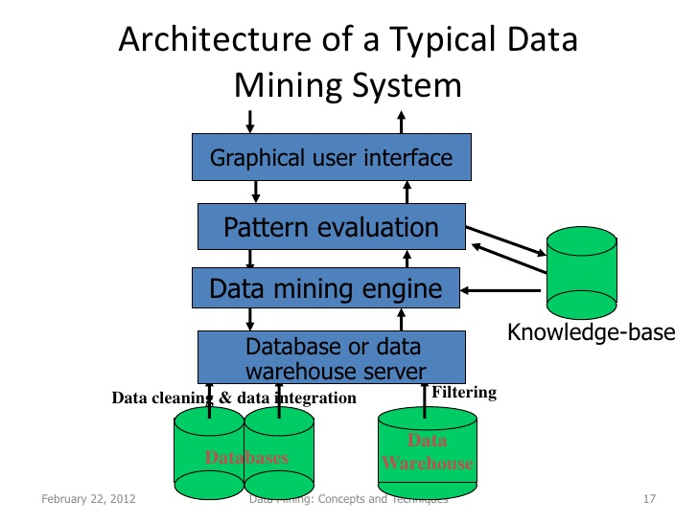
DATA MINING ARCHITECTURE Components

